Slide 1


VISVESVARAYA TECHNOLOGICAL UNIVERSITY, BELAGAVI
“SMART READER: VOICE ASSISTED TEXT READING SYSTEM FOR VISUALLY IMPAIRED ”
Presented by
Under the Guidance of
APOORVA C (4YG18CS001)
CHANDAN KUMAR B K (4YG18CS004)
KAVYA B J (4YG18CS012)
NISHITHA A MURTHY (4YG18CS017)
Dr. Myna A N Ph.d
Assoc. Prof., Dept. of CS&E
NCE, Hassan.
DEPARTMENT OF COMPUTER SCIENCE AND ENGINEERING
NAVKIS COLLEGE OF ENGINEERING, HASSAN
2021-22

Slide 2
CONTENTS
1. Abstract
2. Introduction
3. Problem Statement
4. Literature Survey
5. Existing System
6. Proposed System
7. System Requirements
8. System Design
9. References

Slide 3
ABSTRACT
According to estimates from the World Health Organization (WHO) Prevention of Blindness and Deafness Programme: About 282 million people are visually impaired worldwide: 39 million are blind and 246 million have low vision (severe or moderate visual impairment) It is observed that they are still finding it difficult to roll their day to day life and it is important to take necessary measure with the emerging technologies to help them to live the current world irrespective of their impairments.
In the motive of supporting them, we have proposed a smart specs for the blind persons which can perform text detection thereby producing a voice output.
This can help the visually impaired to read any printed text in vocal form.

Slide 4
ABSTRACT CONT…
A specs inbuilt camera is used to capture the text image from the printed text and the captured image is analysed using Tesseract-Optical Character recognition (OCR).
The detected text is then converted into speech using a compact open source software speech synthesizer, e-Speak.
Finally, the synthesized speech is output through the headphone by (TTS) Text-To-Speech method.
In this project Raspberry Pi is used for the implementation as it provides an interface between camera, sensors, and image processing results, while also performing functions to manipulate peripheral units (Keyboard, USB etc.,).

Slide 5
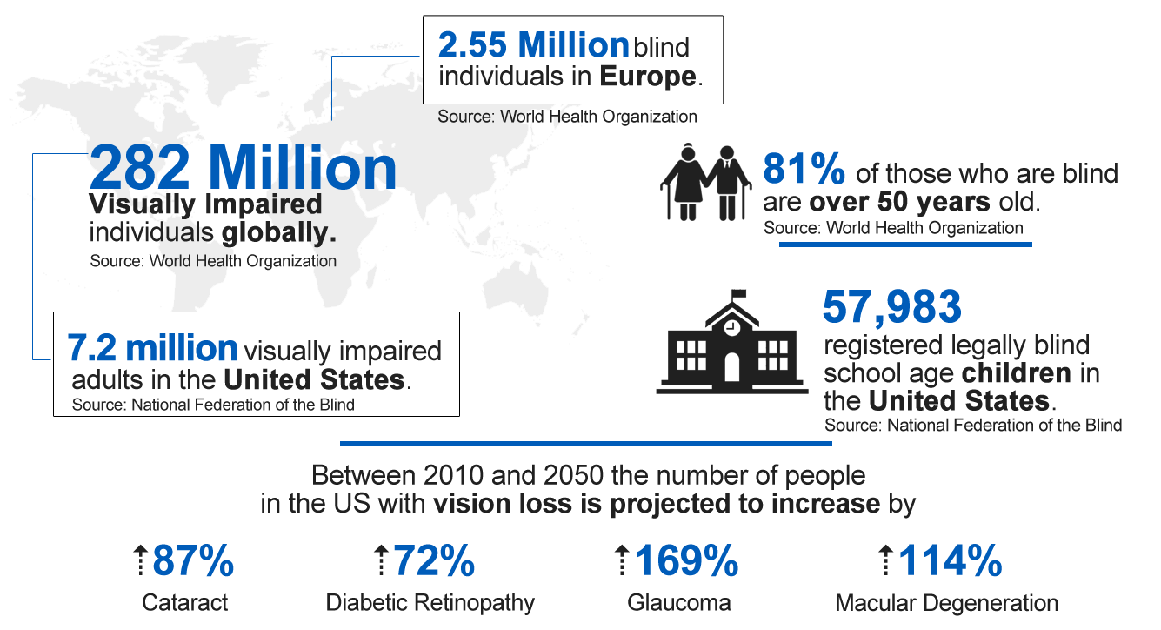
INTRODUCTION
There are 282 billion visually impaired people worldwide Some of the developed countries like the United States, the 2020 National Health Interview Survey(NHIS) reported that an estimated 25.2 million Americans (over 8%) are blind or visually impaired. In India there are 31.6 million are blind or visually impaired according to 2020 survey
Fig1:Classification of Blind People

Slide 6
INTRODUCTION CONT…
Accessing text documents is troublesome for visually impaired people in many situations, such as reading text and accecssing the file
The development of such systems requires the usage of two technologies that are central to these systems, namely optical character recognition for Text Information Extraction (TIE) and Text-To-Speech (TTS) to convert this text to speech.
Text Information Extraction (TIE) is the primary and important function of any assistive reading system and is an integral part of OCR, where it extracts the text from image
A Text-To-Speech (TTS) synthesizer is a computer based system that should be able to read any text aloud, when it is directly introduced in the computer by an operator.

Slide 7
INTRODUCTION CONT…
It is also found that in the field of education and employment, the visually impaired people are finding very difficult to survive. In order to eradicate this problem in the society, we have proposed a product in the form of spectacles with in-built camera for the visually impaired persons.
It would help them read the captured image in the form of audio and also be used by the normal person to read a huge document in a short span of time .
Till now, as per our knowledge there is no product which is developed for visually impaired persons in such a user friendly, with a high accuracy rate and high performance.

Slide 8
PROBLEM STATEMENT
Without vision it can be challenging for a visually impaired person to read the text which is present in their surrounding
Reading a text is a difficult task for the blind person where in our system helps the blind person to read the text
Reading the whole book within a short span of time is a challenging task for the normal people too.
Our proposed system facilitates to read the book where text is in the printed form.

Slide 9
LITERATURE SURVEY
Text detection and recognition have been a challenging issue in different computer vision fields.
There are many research papers that have discussed different methods and algorithms for extracting the text from the images.
The main purpose of this literature review is to view some of these methods and their effectiveness regarding their accuracy rates.

Slide 10
IMAGE PREPROCESSING
In [1] the image captured by camera is processed by MATLAB open software
where an pi camera captures the image.
The Captured image is sent to MATLAB, this is to fetch word-by-word segmentation from the input image and compare it with templates.
The output of detecting text will be processed from each conversion of RGB TO GRAY, GRAY TO BINARY.
The image format should be in the form of (jpeg, png, jpg, bmp etc) are considered for the analysis.
The MATLAB Software is a high-level technical computing language and interactive environment for algorithm development, data analysis and numerical computation

Slide 11
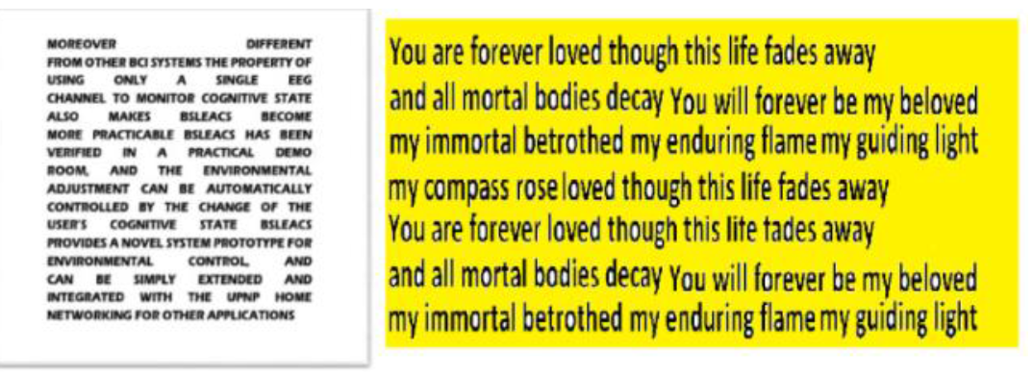
IMAGE PREPROCESSING CONT…
The image captured by a pi camera spilted is in following conditions as described below for detecting corresponding text and matching it with templates prescribed in the below conditions.
Text in the form of Black and White
Text in the form of coloured
Text with image
Text and image merged
Text with different Font Styles
Fig 2: (a) Black and White image (b) Colored image

Slide 12
HARDWARE DESIGN
In [2] The Raspberry Pi has been chosen as the microcontroller from due to its compact size and portable convenience.
In [2] aim is to develop a user friendly device for visually impaired persons which are more compatible and portable for the users to carry the device
The Raspberry Pi 3 Model B which is the third generation Raspberry Pi is employed here. It is a powerful credit-card sized single board computer that can be used for many applications.
The Raspberry Pi 3 Model B brings a more powerful processer, 10 times faster than the first generation Raspberry Pi.

Slide 13
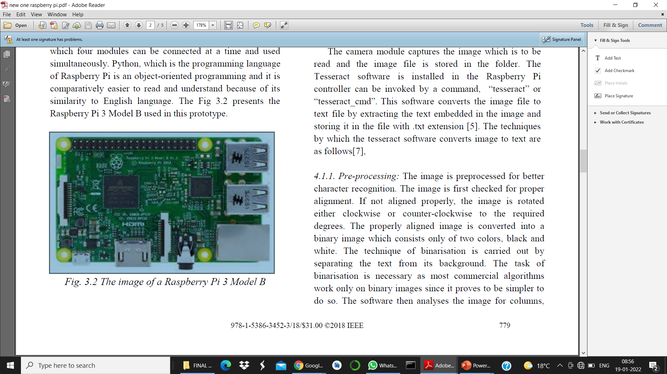
HARDWARE DESIGN CONT…
It adds wireless LAN & Bluetooth connectivity making it the ideal solution for powerful connected designs. The technical specification of
Raspberry Pi 3 model B include Broadcom BCM2837
processor, quad core ARM Cortex-A53, clock speed of
1.2GHz, 1 GB RAM, RJ45 port for network connectivity,
wireless LAN (Wi-Fi) and Bluetooth 4.1, four USB Ports,
GPIOs and a Camera Interface with a 15-pin MIPI
Fig 3: The image of a Raspberry Pi 3 Model B

Slide 14
OCR MODULE (OPTICAL CHARACTER RECOGNITION)
Text Information Extraction is the first and important function of any assistive reading system and is an integral part of OCR because this process determines the intelligibility of the output speech.
OCR is used to recognize words. It can recognize characters, words and sentences without any mistakes.
OCR has a high rate of recognition which is the electronic conversion of photographed images of typewritten or printed text into computer-readable text [3]

Slide 15
OCR MODULE CONT…
In [4] MSER (Maximally Stable External Regions) is used for text recognition in natural scene images
MSER method provides an accuracy and robustness in detecting texts in natural scene images.
MSER method to detect almost all characters from any image.
The datasets used for this system are ICDAR 2011 and Multilingual datasets.
The results showed that the MSER has achieved 88.52% in character level recall [4].

Slide 16
OCR MODULE CONT…
In [5] novel Scene Text Recognition is an algorithm that mainly depended on machine learning methods. Two types of classifiers have been designed to achieve more accuracy
The first one is developed to generate candidates, but the second one was for filtering of candidates that are not text.
A scene text recognition technique has been developed to take advantage of multi-channel information. two datasets have been used in this study, ICDAR 2005, ICDAR 2011.
This method has achieved significant results in different evaluation protocols

Slide 17
OCR MODULE CONT…
In [6]. photo OCR which is a system designed to detect and extract any text from any image using machine learning techniques, it also used different distributed language modeling.
The goal of this system was to recognize any text from any challenging image such as poor quality or blurred images.
This system has been used in different application such as Google Translate. The datasets that are been used for this system are ICDAR and SVT. the results showed that the processing time for text detection and recognition is around 600ms for one image.

Slide 18
OCR MODULE CONT…
In this [7] the main aim is to detect the text in the image with an high accuracy before converting it into vocal form here we use the
EAST is an abbreviation of an Efficient and Accurate Scene Text Detector.
This method is a simple and powerful pipeline that allows detecting a text in natural scenes, and it achieves high accuracy and efficiency. Three datasets have been used in this study, ICDAR 2015, COCO-Text and MSRA-TD500.
The experiment has shown that this method has better results than previous methods regarding accuracy and efficiency

Slide 19
TTS(Text-To-Speech) MODULE
In [8] they propose a high-quality next generation Text To Speech (TTS) synthesis systems to help visually impaired person
A Text classifier (TC) is included in the TTS architecture in order to automatically conduct the selection of the most appropriate domain for synthesizing the input text
This can be done by new TTS strategy called multi domain TTS (MD - TTS) for synthesizing among different domains.

Slide 20
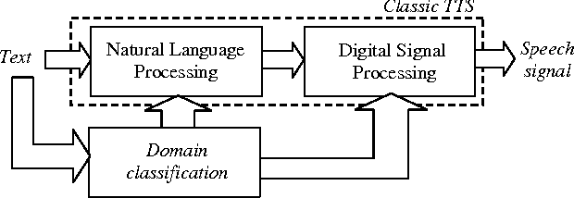
TTS MODULE CONT…
Fig 4: Block diagram of multi domain Text-To-Speech

Slide 21
TTS MODULE CONT…
Gaining fluency in any language is a cumbersome task. To make it easy so many software’s are existing now a days.
In [9] aim is to develop a software that enhances the user's way of speech through correctness of pronunciation following the phonetics. It also facilitates an extra add-on feature which nourishes the user's communication skills by an option of text to speech conversion also.
Enhancing the fluency in the speech and the quality of the output is under consideration
This is done by using the natural language processing, phonetics of the language in [9]

Slide 22
TTS MODULE CONT…
In [10] for better output and an clear audible e-speak is used.
E-Speak is a compact open source software speech synthesizer for English and other languages, for Linux and Windows which uses a "formant synthesis" method.
This allows many languages to be provided in a small size. The main advantage of using e-Speak is that the speech is clear, and can be used at high speeds.
E-Speak is available as a command line program (Linux and Windows) to speak text from a file or from stdin and shared library version for use by other programs. (On Windows this is a DLL).
Raspbian OS follows the Advanced Linux Sound Architecture (ALSA) for managing audio devices.

Slide 23
EXISTING SYSTEM
The idea of “Smart Glasses” is to create wearable computer glasses for a different purpose.
These uses determine the type of glasses that are needing to be created.
In the early stage, the “Smart Glasses” were simple and provide basic tasks which serve as a front-end display for the remote system.
As they were able to read the text which are in the image by using some of the modules like OCR,TTS methods
Now “Smart Glasses” become more efficient and provide several features

Slide 24
PROPOSED SYSTEM
This system consists of a prototype of assistive text reading.
The concept of proposed system is the idea of developing specs reader based text reading system for visually impaired persons.
There are three different modules in this system: Camera module, Optical Character Recognition Module and Text-To-Speech Module
This explains the text reading system for visually impaired users for their self independent
The main purpose of this project is to present a progressive work for developing an assistive aid for visually impaired.
It will help them in object identification by using sensors and obstacle detection as well as reading newspapers and books.

Slide 25
SYSTEM REQUIREMENTS
SOFTWARE REQUIREMENTS
Operating System: Raspbian operating system
Scripting Language: Python 3
OS Family : UNIX
Speech Synthesizer software : E-Speak
Open-Source Engine : Tesseract – OCR,OPENCV
HARDWARE REQUIREMENT
Processor : Any Processor above 500 MHz
RAM : 8.00GB and above
Storage : 500GB and above
INPUT DEVICE : : Raspberry pi Model B+, web camera
CONNECTIVITY : Wireless LAN and Bluetooth

Slide 26
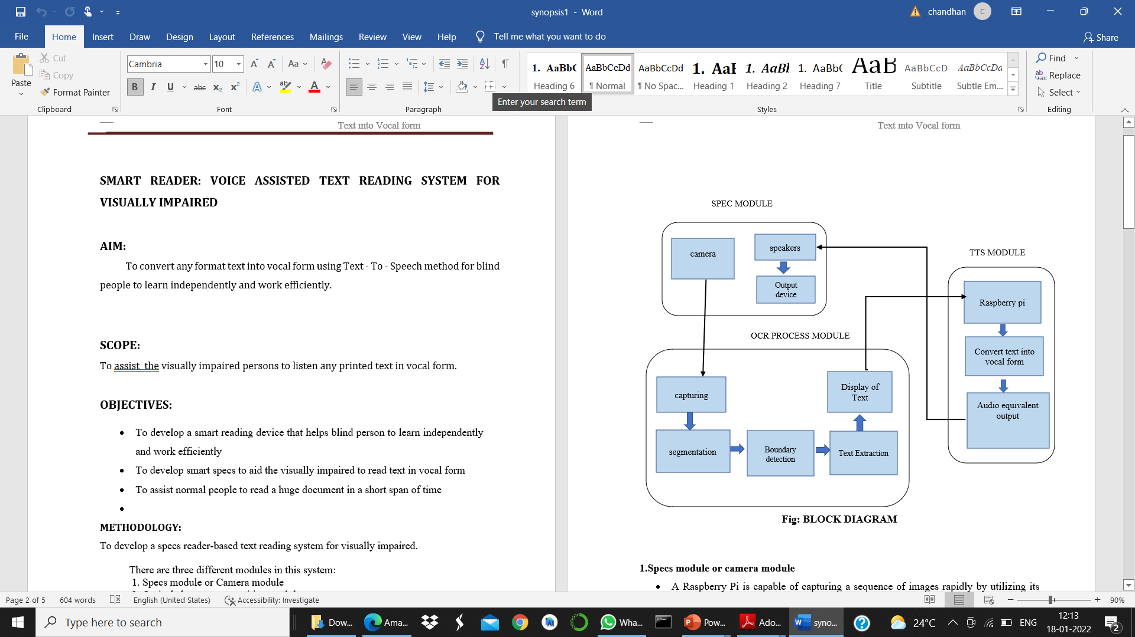
SYSTEM DESIGN
Fig 5: Block Diagram

Slide 27
METHODOLOGY CONT…
To develop a specs reader-based text reading system for visually impaired.
There are three different modules in this system:
1. Specs module or Camera module
2. Optical character recognition module
3.Text -To- Speech module
1.Specs module or camera module
A Raspberry Pi is capable of capturing a sequence of images rapidly by utilizing its video- capture port with JPEG encoder.
Raspberry Pi maintains a queue of images and maintain them as the captured images

Slide 28
METHODOLOGY CONT…
The captured image is processed by Optical Character Recognition (OCR) process.
After the OCR process, Text -To -Speech method is used to detect text and convert into vocal form
The audio output is produced through the headset connected to the Raspberry Pi.
2.Optical character recognition module:
In order to read the words in a paragraph accurately, Tesseract Optical Character Recognition (OCR) is chosen for the project.
The system is used to detect and extract any text from any images using machine learning techniques

Slide 29
METHODOLOGY CONT…
It can recognize characters, words and sentences without any mistakes.
OCR has a high-rate recognition which is the electronic conversion of photographed images.
3.Text - To - Speech module:
E-Speak is a compact open-source software speech synthesizer for English and other languages, for Linux and Windows which uses a "formant synthesis" method.
E-Speak is available as a command line program (Linux and Windows) to speak text from a file or from stdin and shared library version for use by other programs.
Raspbian OS follows the Advanced Linux Sound Architecture (ALSA) for managing audio devices

Slide 30
REFERENCES
[1] Sanjana.B1, J.RejinaParvin “Voice Assisted Text Reading System for Visually Impaired Persons Using TTS Method “ IOSR Journal of VLSI and Signal Processing (IOSR-JVSP),vol -2 ,issue- 5,pp -3-5 (2016).
[2] Dr. I S Akila,Akshaya B, Deepthi S, Sivadharshini P,“A Text Reader for the Visually Impaired using Raspberry Pi” Proceedings of the Second International Conference on (ICCMC 2018) IEEE Conference, vol-6, issue - 4,pp – 778 -779 Oct(2018)
[3] Abhishek Mathur, Akshada Pathare, Prerna Sharma “AI based Reading System for Blind using OCR” Proceedings of the Third International Conference [ICECA ] IEEE Conference,vol-pp -39 Sep(2019)

Slide 31
CONT…
[4] Yin, X. C., Yin, X., Huang, K., & Hao, H. W, Robust text detection in natural scene images. IEEE transactions on pattern analysis and machine intelligence, vol -14 ,issue – 3,pp- 970-983(2014)
[5] Koo, H. I., & Kim, D. H, Scene text detection via connected component clustering and nontext filtering. IEEE transactions on image processing, vol -4 , issue-6 ,pp- 2296-2305 (2013)
[6] Bissacco, A., Cummins, M., Netzer, Y., & Neven, Photoocr: Reading text in uncontrolled conditions. In Proceedings of the IEEE International Conference on Computer Vision ,vol -3,issue-3,pp-785-792(2013)
[7] Zhou, X., Ylao, C., Wen, H., Wang, Y., Zhou, S., He, W., & Liang, J. .EAST: an efficient and accurate scene text detector. In Proceedings of the IEEE conference on Computer Vision and Pattern Recognition ,vol-8,issue-4,pp -2642(2017)

Slide 32
CONT…
[8] Alías F. Sevillano X. Socoró J. C Gonzalvo X. (2008), “Towards high-quality next-generation text-to-speech synthesis”, IEEE Trans. Audio, Speech, Language Process, Vol. 16, issue 7, pp. 1340-1354(2008).
[9] Chucai Yi. YingLiTian.AriesArditi,”PortableCamera-based Assistive Text and Product Label Reading fromHand-held Objects for Blind Persons”, IEEE/ASMETransactions on Mechatronics, vol 3 ,issue-2 ,pp-1 -3(2014)
[10] Ani R, Effy Maria, J JameemaJoyce,Sakkaravarthy, Dr.M.A.Raja,”Smart Specs: Voice Assisted Text Reading system for Visually Impaired Persons Using TTS Method”, IEEE International Conference on Innovations in Green Energy and Healthcare Technologies(ICIGEHT),vol-21 ,issue -2pp -3(2017

Slide 33
THANK YOU

